Slide 1

BUYALL – Final Project
Presented by Murugappan K
mkrishnamur6@dedalus.eu
9840972145

Slide 2

Agenda
Introduction​
Environment Setup
Workflow
​Features

Slide 3
Introduction​
BuyALL Project mainly used to sale the products.
Main purpose of this project is to showcase or explore the Angular features taught during training period

Slide 4
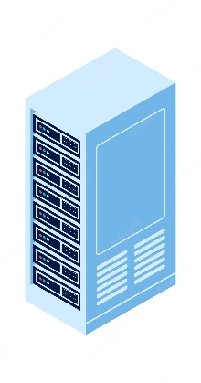
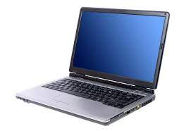


Environment Setup
Images
Nginx Server
http://localhost:8090/
Data
json-server-auth
json-server-auth --port 4500 data.json
http://localhost:4500/
Output – Browser
http://localhost:4200/
Development Laptop

Slide 5
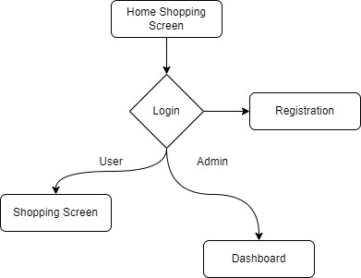
Workflow

Slide 6
Features
Lazy Loading
Routing
Admin & User Flow
Pipes
Chart
Directives

Slide 7
Thank You

